Slide 1

DBA5103
Operations Research and Analytics
Zhenyu Hu
Semester I, 2026/2027

Slide 2
Network Flow Models
Basic Graph Theory
General Network-Flow Problem
Special Network Models
Solution Methods
Application of Network Models

Slide 3
Basic Graph Theory

Slide 4
Undirected Network
A network is denoted as G = (N, A), where N is the set of nodes and A is the set of undirected arcs.
2
3
1
6
4
5

Slide 5
Directed Network
A network whose arcs are all ordered pairs of distinct nodes.
2
3
1
6
4
5

Slide 6
Path
A path is a sequence of arcs which connect a sequence of distinct nodes. Directed path requires the arcs to be in the same direction
2
3
1
6
4
5

Slide 7
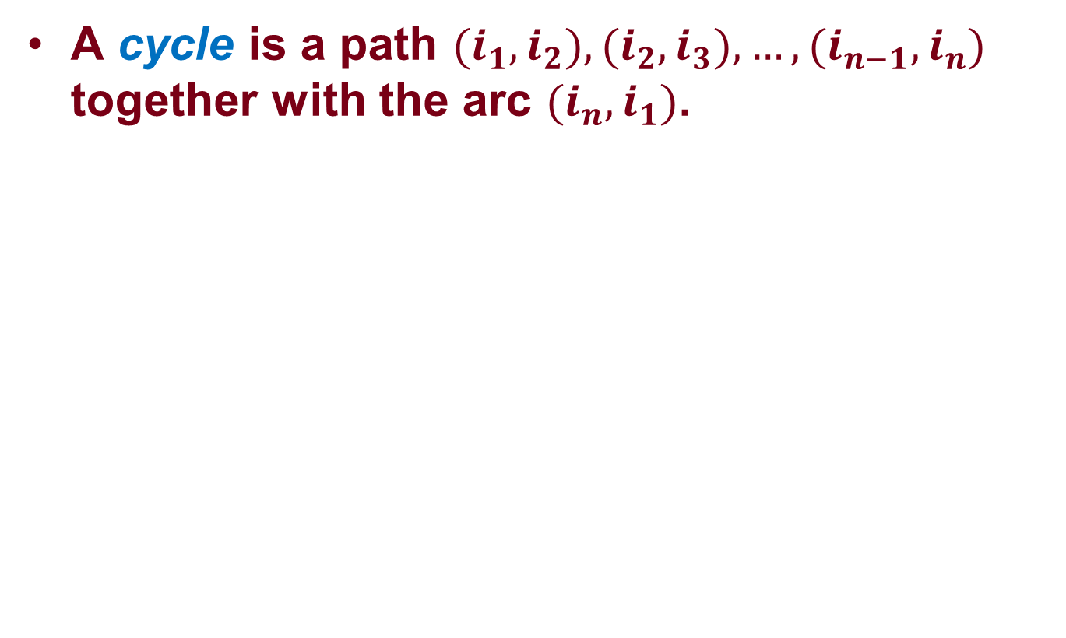
Cycle
A cycle is a path ${(i}_{1},i_{2}),{(i}_{2},i_{3}),…,{(i}_{n−1},i_{n})$ together with the arc ${(i}_{n},i_{1})$.
2
3
1
4

Slide 8
Acyclic network
A (directed) graph is acyclic if it contains no (directed) cycle.
2
3
1
6
4
5

Slide 9
Connectivity
Two nodes i and j are connected if the graph contains at least one path from node i to node j.
A graph is connected if every pair of its nodes is connected. Otherwise, the graph is disconnected.
2
3
Connected components
1
6
4
5

Slide 10
Tree
A tree is a connected graph that contains no cycles.
child
2
3
1
6
parent
4
5

Slide 11
Spanning Tree
A spanning tree T of a connected graph G satisfies: T is a tree and T contains every node in G
2
3
1
6
4
5

Slide 12
Properties of Spanning Tree
There are exactly N – 1 arcs; it is acyclic; it connects all N nodes.
Conversely, if a set of N – 1 arcs is connected to all N nodes, then it is a spanning tree.

Slide 13
Other Special Graphs: Bipartite Graph
The node is separated into two sets: arcs only connect nodes in different sets.
1
4
Every tree is a bipartite graph, but not vice versa.
2
3
5

Slide 14
Other Special Graphs: Complete Graph
Every pair of node is connected by an arc.
How many arcs are in a complete graph with n nodes?
1
2
3
4
5

Slide 15
Other Special Graphs: Complete Bipartite Graph
Every node in one set is connected with every other node in the other set.
1
4
2
3
5

Slide 16
General Network-Flow Problem

Slide 17
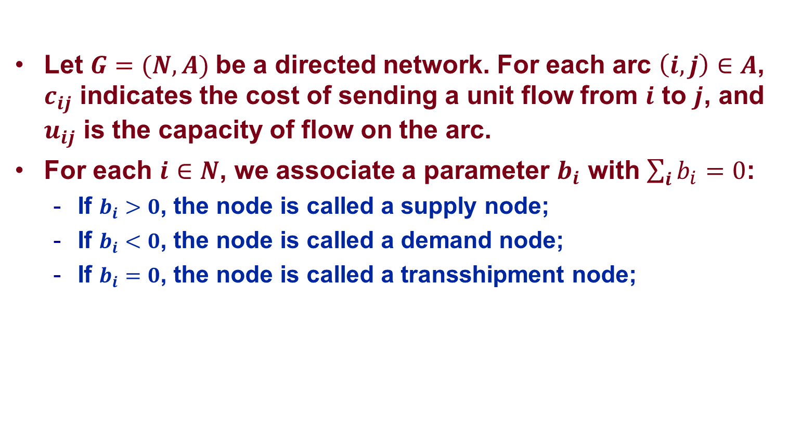
Minimum Cost Network Flow Problem
Let $G=(N,A)$be a directed network. For each arc $\left(i,j\right)∈A$, $c_{ij}$ indicates the cost of sending a unit flow from $i$ to $j$, and $u_{ij}$ is the capacity of flow on the arc.
For each $i∈N$, we associate a parameter $b_{i}$ with $\sum_{i}{b_{i}}=0$:
  If $b_{i}>0$, the node is called a supply node;
  If $b_{i}<0$, the node is called a demand node;
  If $b_{i}=0$, the node is called a transshipment node;
(4, $2)
2
4
(-5)
(15, $4)
(10, $6)
(20)
1
(∞, $2)
(∞, $2)
(15, $1)
(8, $4)
(5, $3)
3
(4, $1)
5
(-15)

Slide 18
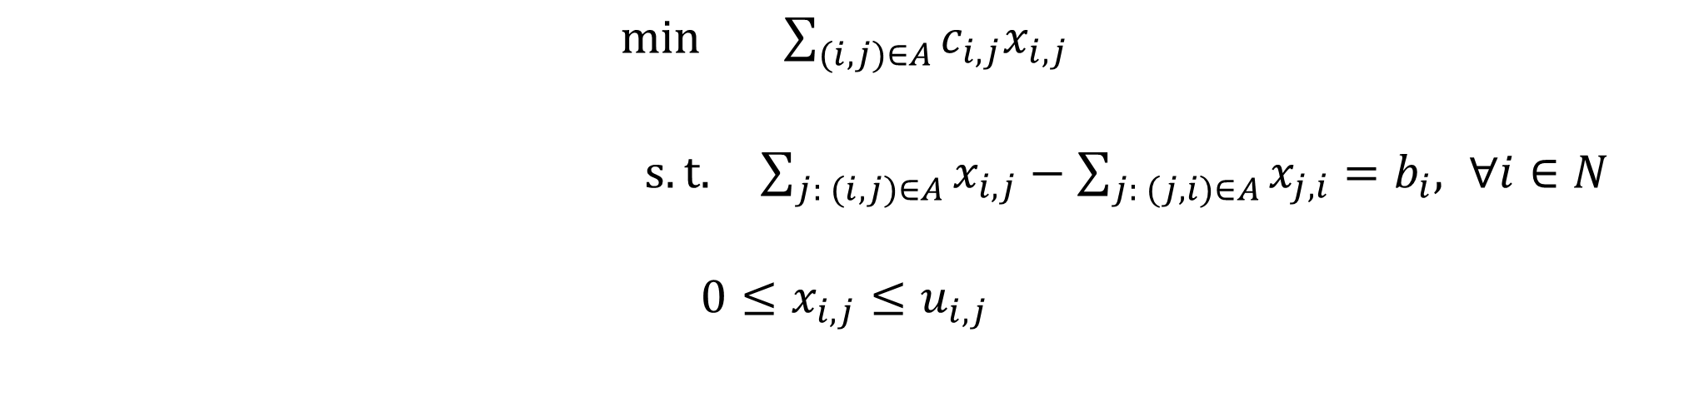
Minimum Cost Network Flow Problem
$\min_{}{\sum_{(i,j)∈A}{{c_{i,j}x}_{i,j}}}$
$s.t. \sum_{j: (i,j)∈A}{x_{i,j}}−\sum_{j: (j,i)∈A}{x_{j,i}}=b_{i}, ∀i∈N$
$${0≤x}_{i,j}≤u_{i,j}$$

Slide 19
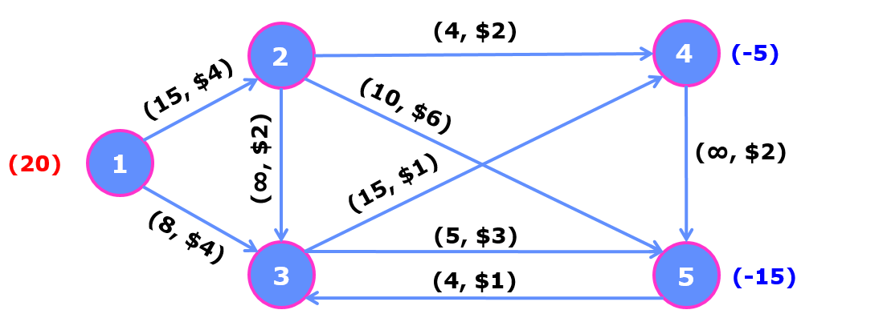
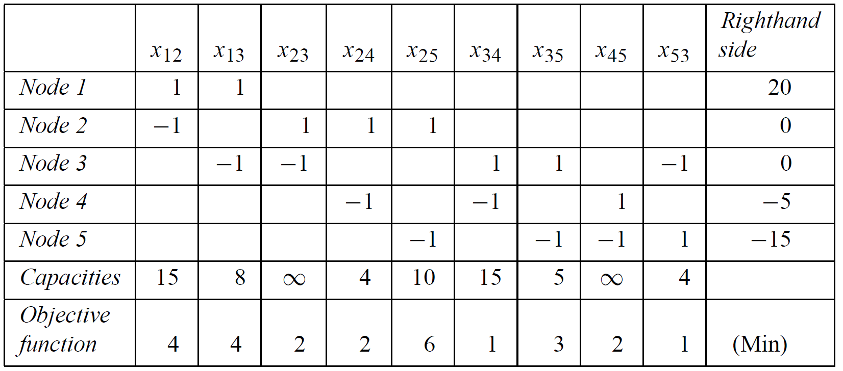
Network Flow Problem: LP Tableau

Slide 20
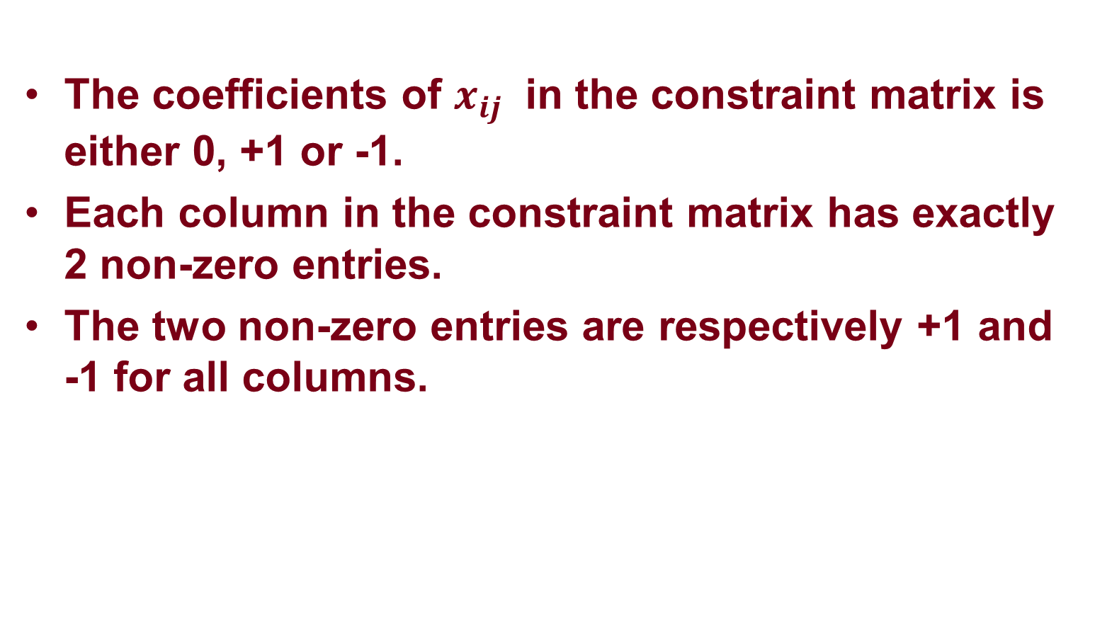
Network Flow Problem: Special Structure
The coefficients of $x_{ij}$ in the constraint matrix is either 0, +1 or -1.
Each column in the constraint matrix has exactly 2 non-zero entries.
The two non-zero entries are respectively +1 and -1 for all columns.

Slide 21
Special Network Models

Slide 22


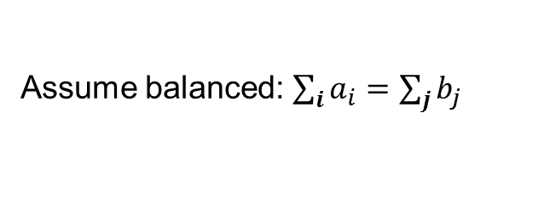
Transportation Problem
  m plants, n distribution centers.
  ai supply from plant i, i=1,2,…,m
  bj demand of distribution center j, j=1,2,…,n
  cij cost of transportation from i to j
Transportation Problem is a special case of min-cost flow problem. (why?)
Assume balanced: $\sum_{i}{a_{i}}=\sum_{j}{b_{j}}$

Slide 23
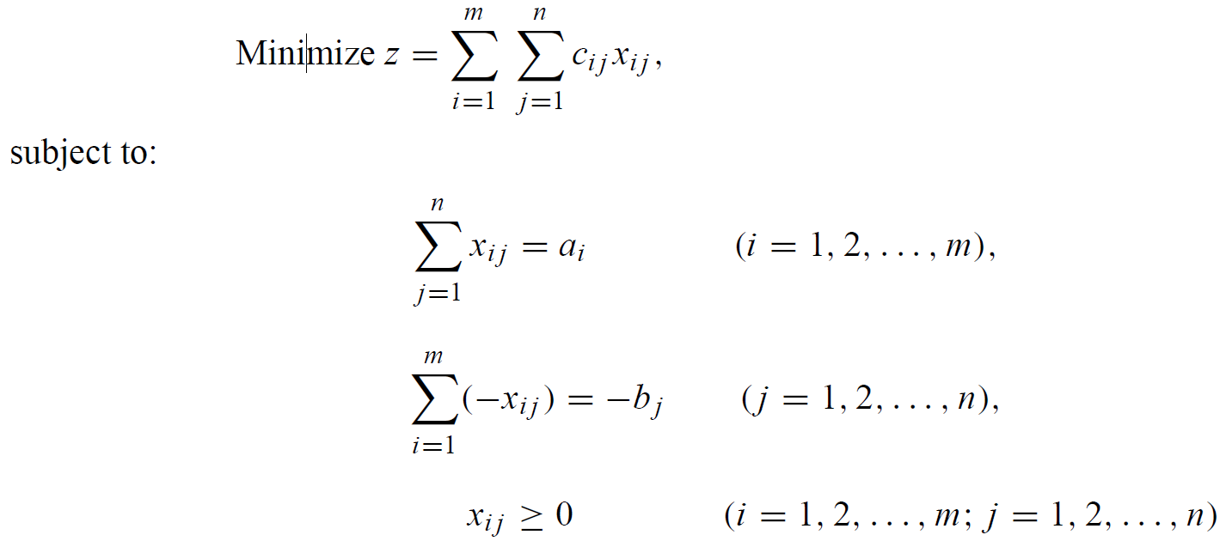
Transportation Problem: Network Formulation

Slide 24
Assignment Problem
Determine the minimal cost of assigning elements of a set A to elements of another set B.
Applications
  People to projects
  Jobs to machines
  Boarding gate to aircrafts
  Graduates to internships
  …

Slide 25
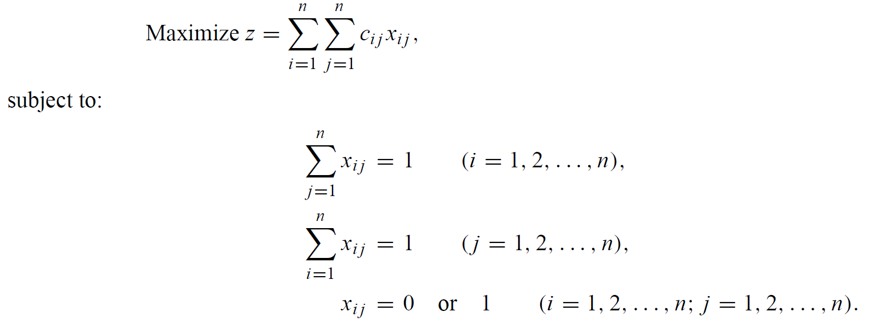

Assignment Problem: Network Formulation
What if the graph is not a complete graph?

Slide 26
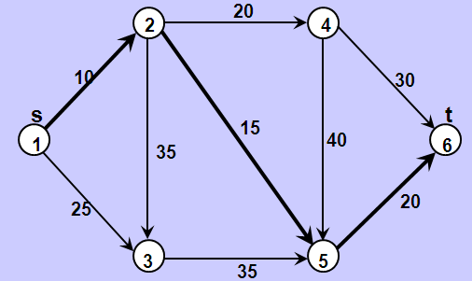
Shortest Path Problem
Identify the shortest path from a source node to a sink node through the given network.
  Finding a path of minimum length
  Finding a path taking minimum time
  Finding a path of maximum reliability.

Slide 27
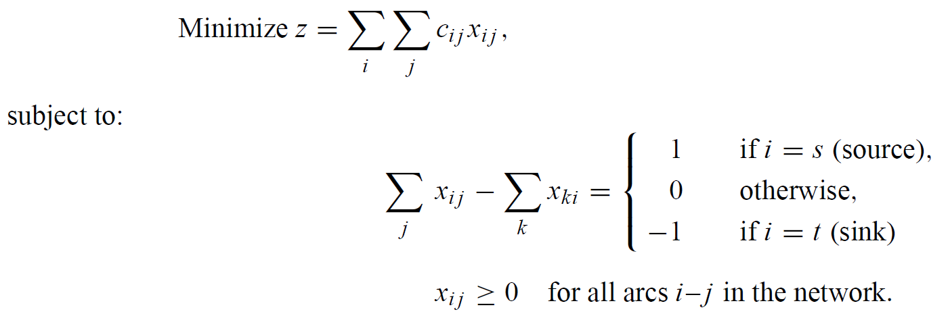

Shortest Path Problem: Network Formulation

Slide 28
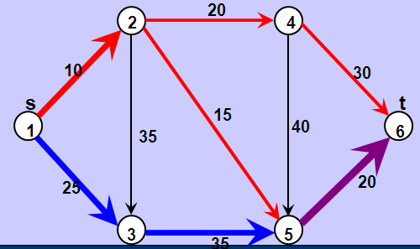
Maximum Flow Problem
Determine the maximum flow that can be sent from a given source node to a sink node in a capacitated network.
Determine maximum flow of
  petroleum products in a pipeline network,
  cars in a road network,
  message in a telecommunication network,
  electricity in an electrical network.

Slide 29
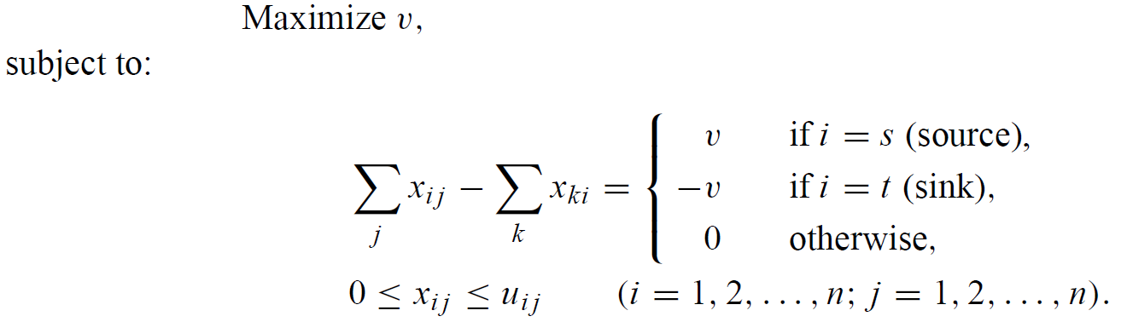
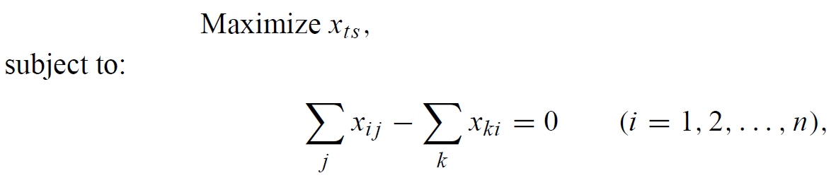
Maximum Flow: Network Formulation

Slide 30
Solution Methods

Slide 31
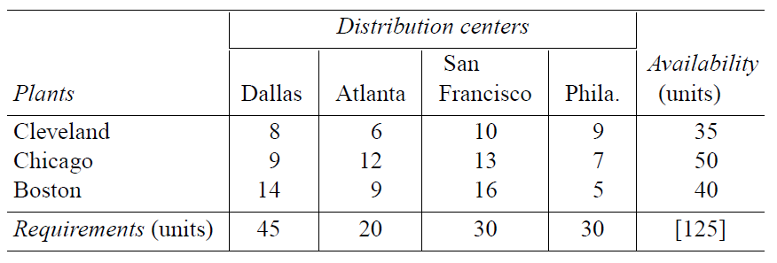
Transportation Problem: Example

Slide 32
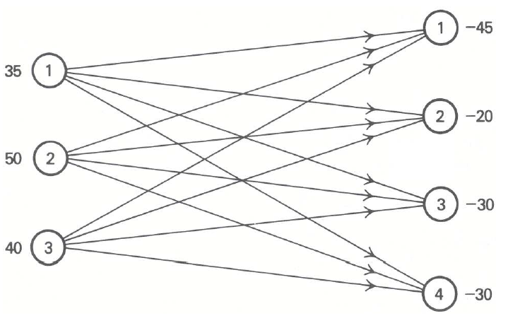
Transportation Problem: Example

Slide 33
Solving Transportation Problem (TP): Procedure
Obtaining an initial solution;
Checking optimality condition;
Developing a procedure to improve the current solution if the optimality condition is not met

Slide 34
Solving TP: Finding Initial Solution

Slide 35
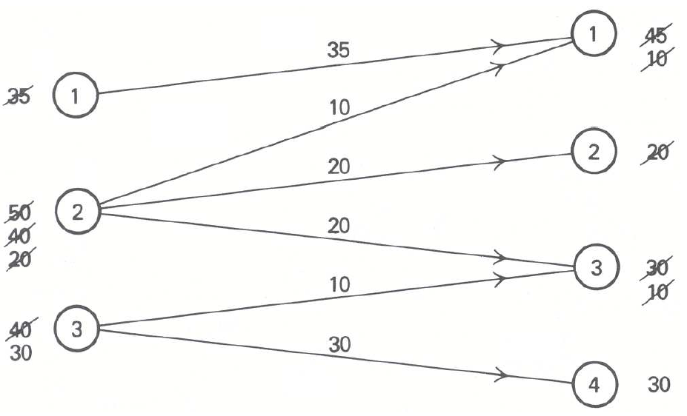
Finding Initial Solution : Myopic

Slide 36
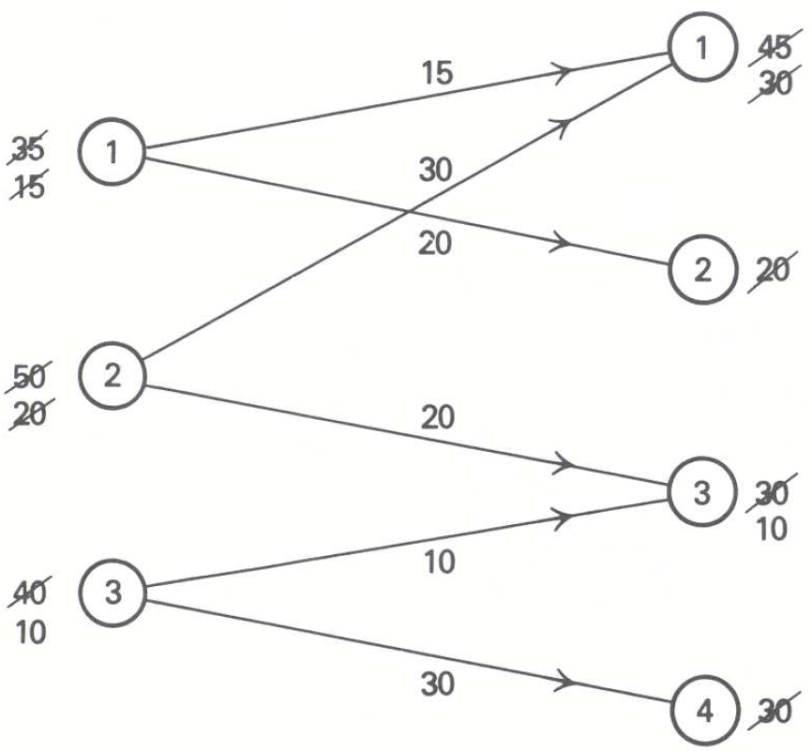
Finding Initial Solution : Greedy Algorithm

Slide 37
Properties of the Initial Solution
In both methods, the solutions have exactly (m + n - 1) arcs;
Every node in the network is connected through the solution;
There is no cycle in the solution.
With the above properties, what do we know about the solution?

Slide 38
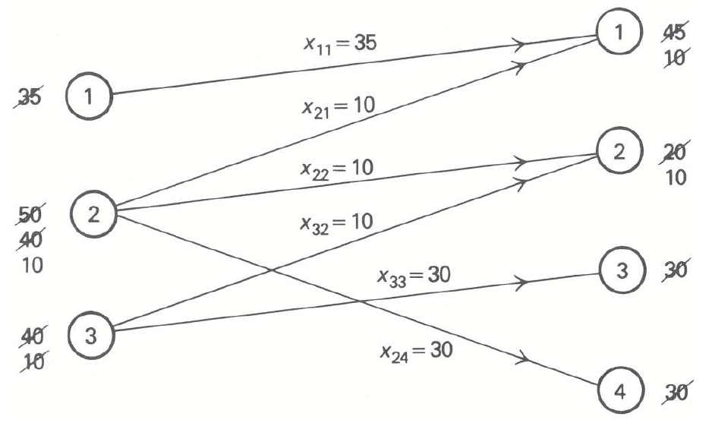
Finding Initial Solution : Spanning Tree

Slide 39
Spanning Tree vs. BS
Is a solution generated by spanning tree a basic solution?
  Is the solution unique?
Is a basic solution a spanning tree?
  How many basic variables do we have?
  It cannot have a cycle (otherwise one can have more than one solution to the equation).
In transportation problem, a vector (not necessarily feasible) is a basic solution if and only if it is generated by a spanning tree.

Slide 40
Solving TP: Python Implementation

Slide 41
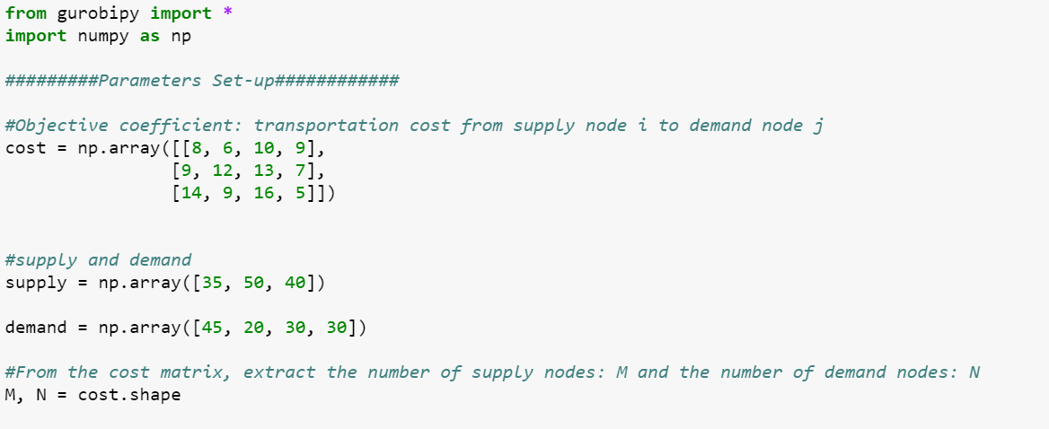
Solving TP: Python Implementation

Slide 42
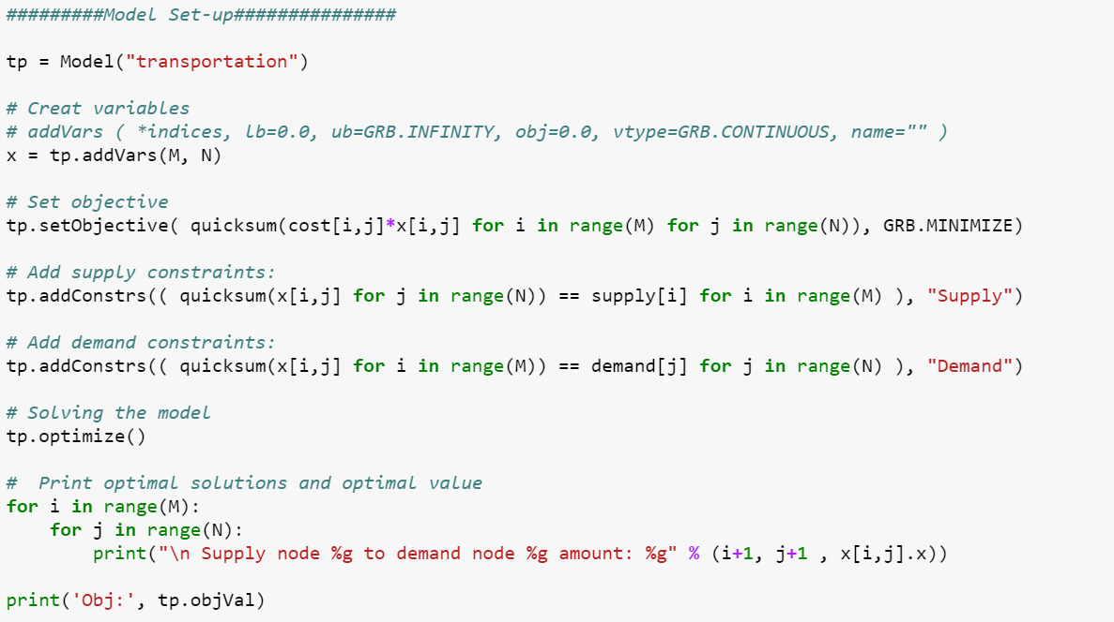
Solving TP: Python Implementation

Slide 43
Application of Network Models

Slide 44
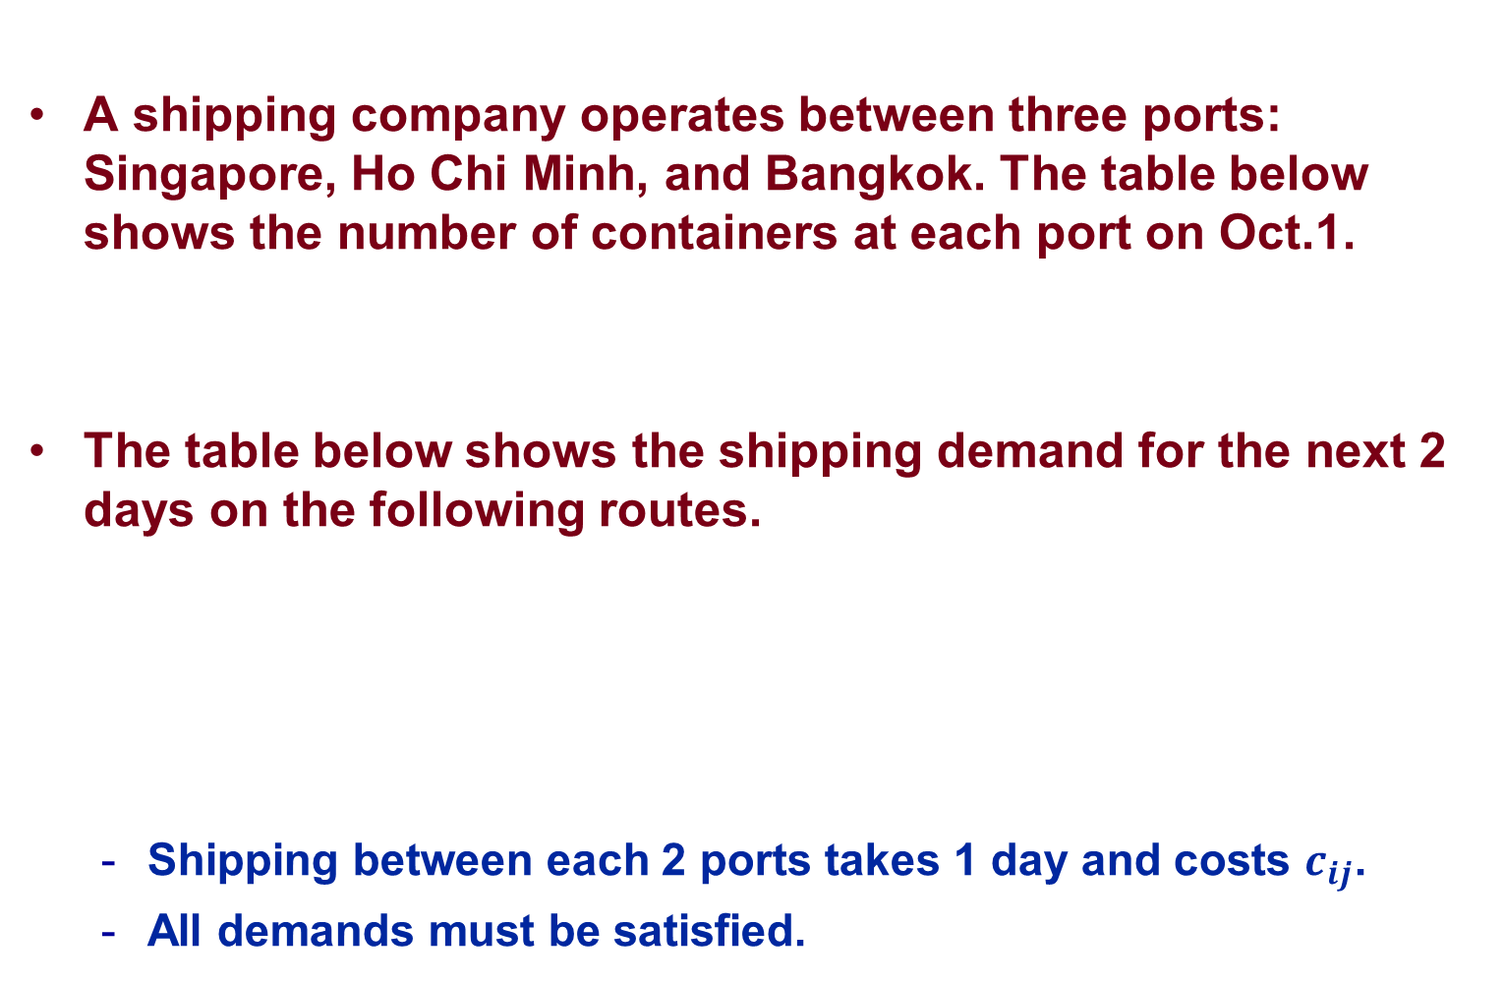
Container Repositioning
A shipping company operates between three ports: Singapore, Ho Chi Minh, and Bangkok. The table below shows the number of containers at each port on Oct.1.
The table below shows the shipping demand for the next 2 days on the following routes.
  Shipping between each 2 ports takes 1 day and costs $c_{ij}$.
  All demands must be satisfied.
Singapore | Ho Chi Minh | Bangkok
5 | 3 | 2
Route | Oct.1 | Oct.2
S→H | 3 | 1
H→B | 2 | 5
B→S | 1 | 2

Slide 45






Time-Expanded Network
Oct.1
Oct.2
Oct.3
(5)
S
S
S
(3, $$c_{SH}$)
(1, $$c_{SH}$)
(-10)
(3)
H
H
H
t
(2, $$c_{HB}$)
(5, $$c_{HB}$)
(1, $$c_{BS}$)
(2, $$c_{BS}$)
(2)
B
B
B

Slide 46
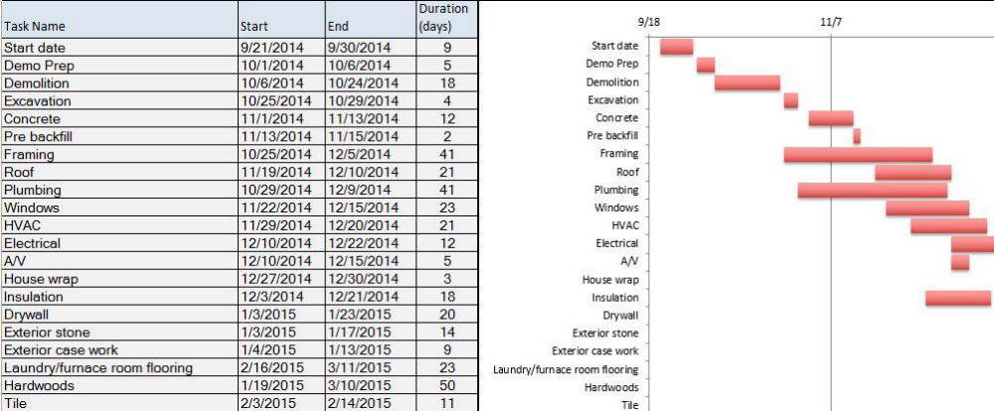
Project Management

Slide 47
Project Management
Activity | Description | Immediate Predecessors | Estimated Duration
1 | Wait until last 3 weeks | --- | 4 weeks
2 | Looking for topic and data | 1 | 1 week
3 | Looking for reference | 2 | 1 week
4 | Cleaning data | 2 | 1 week
5 | Building model | 3 | 1 week
6 | Coding | 4, 5 | 2 weeks
7 | Writing motivation/model | 5 | 2 weeks
8 | Analyzing results | 6 | 1 week
9 | Finalizing report | 7, 8 | 1 week
Deadline: 7 weeks

Slide 48
Activity-on-node (AON) Project Network
1
4
1
2
1
3
4
1
1
5
2
7
6
2
1
8
9
1
Finish

Slide 49
Crashing Projects
Activity | Description | Maximum Reduction Time | Crash Cost per Week
1 | Wait until last 3 weeks | 4 weeks | 1
2 | Looking for topic and data | 0 week | 0
3 | Looking for reference | 0 week | 0
4 | Cleaning data | ½ week | 2
5 | Building model | ½ week | 2
6 | Coding | 1 week | 2
7 | Writing motivation/model | ½ week | 2
8 | Analyzing results | 0 week | 0
9 | Finalizing report | ½ week | 2
Objective: Minimizing the crash cost while meeting the deadline.

Slide 50
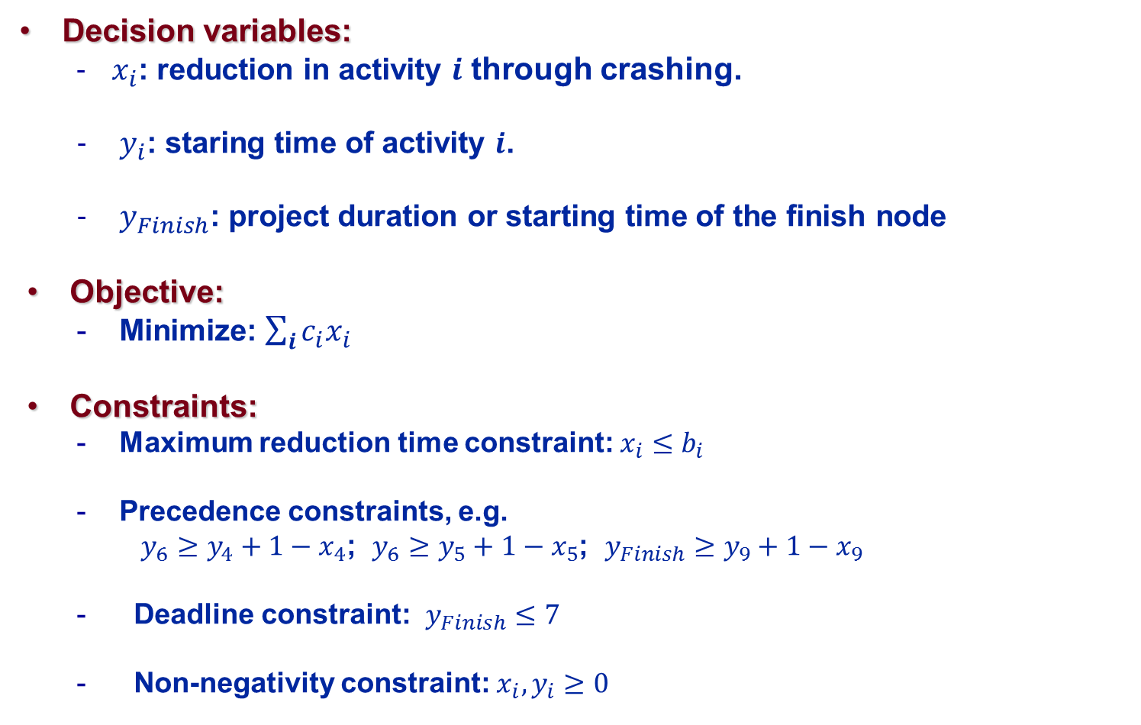
Linear Programming Formulation
Decision variables:
  $x_{i}$: reduction in activity $i$ through crashing.
  $y_{i}$: staring time of activity $i$.
  $y_{Finish}$: project duration or starting time of the finish node
Objective:
  Minimize: $\sum_{i}{{c_{i}x}_{i}}$
Constraints:
  Maximum reduction time constraint: $x_{i}≤b_{i}$
  Precedence constraints, e.g.
  $y_{6}≥y_{4}+1−x_{4}$; $y_{6}≥y_{5}+1−x_{5}$; $y_{Finish}≥y_{9}+1−x_{9}$
  Deadline constraint: $y_{Finish}≤7$
  Non-negativity constraint: $x_{i},y_{i}≥0$

Slide 51
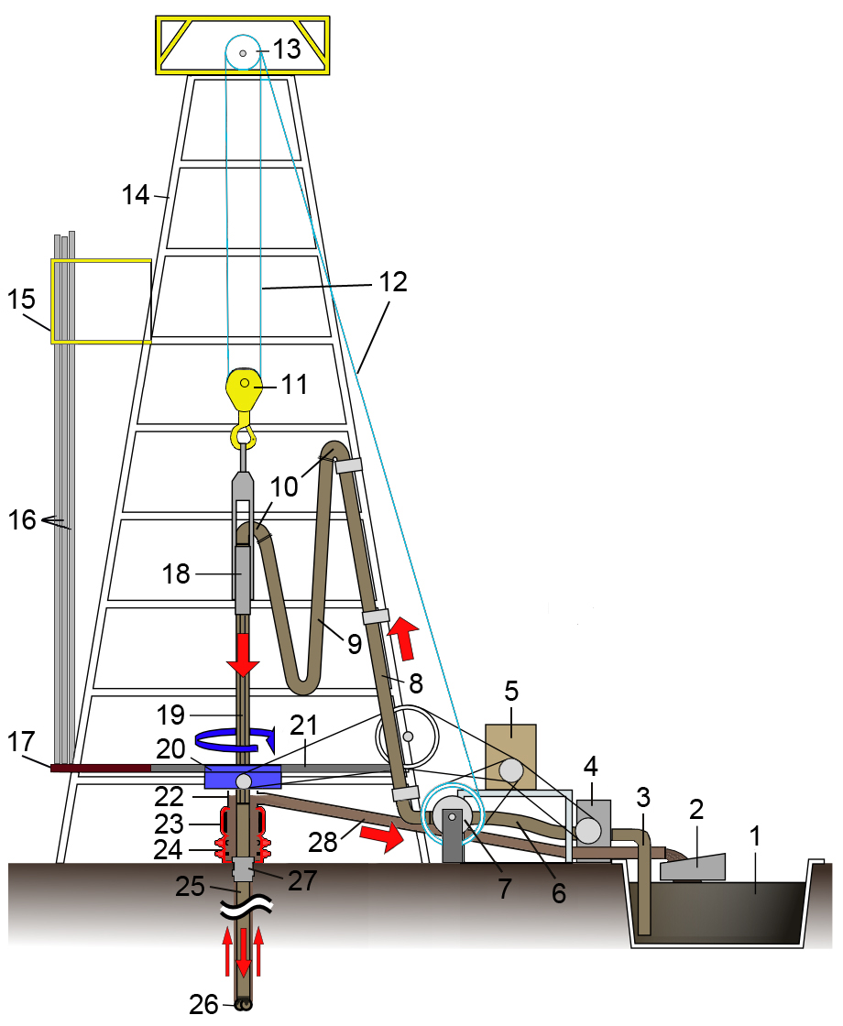
Application: Manufacturing of Complex Machine

Slide 52
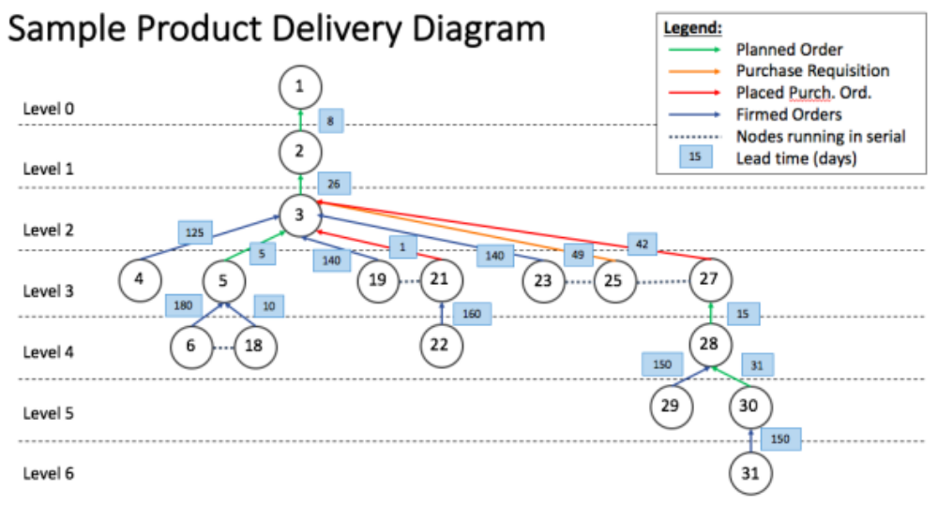
Application: Manufacturing of Complex Machine
Source: Chen Changhua, Goh Zhi Wen, Chuah Sim Teng, Ng Changwei and Yang Kan, “Optimizing Expediting Cost for Complex Product Delivery”, Term Paper, 2017

Slide 53
Application: Manufacturing of Complex Machine
The real business problem:
  6 levels.
  1307 nodes.
Decisions:
  Expediting decisions
  Outsourcing decisions
Objective:
  Minimize expediting cost + outsourcing cost
  Meeting the final product delivery time
Other considerations:
  Random lead time
  Multiple suppliers to outsource from

Slide 54



Process Flexibility: Dedicated System
100
20
100
140
100
140

Slide 55
Full Flexible System
100
20
100
140
100
140

Slide 56



How to Compute the Maximum Sales?
100
20
100
80
100
140
100
100
100
140
100
120

Slide 57
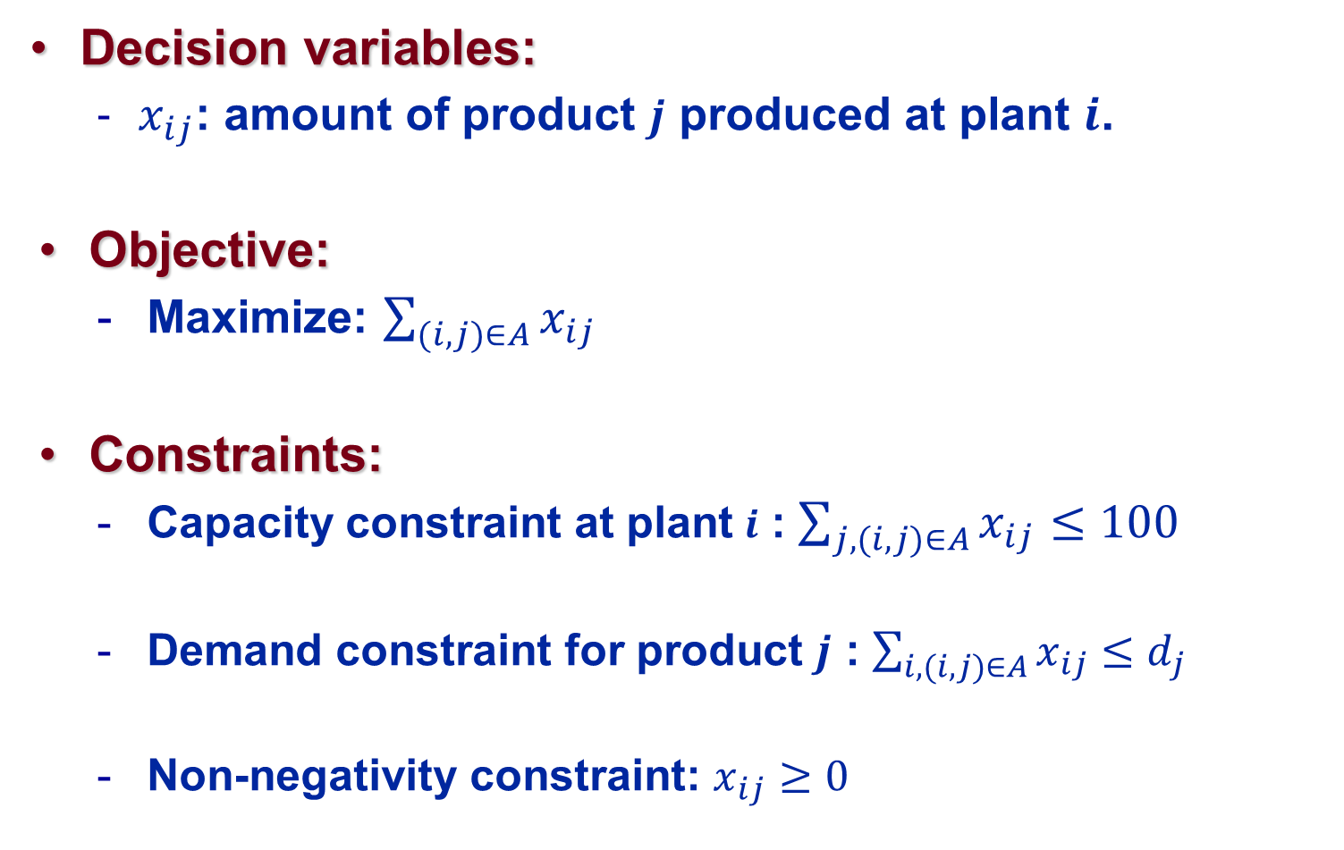
Linear Programming Formulation
Decision variables:
  $x_{ij}$: amount of product $j$ produced at plant $i$.
Objective:
  Maximize: $\sum_{(i,j)∈A}{x_{ij}}$
Constraints:
  Capacity constraint at plant $i$ : $\sum_{j, (i,j)∈A}{x_{ij}}≤100$
  Demand constraint for product $j$ : $\sum_{i, (i,j)∈A}{x_{ij}}≤d_{j}$
  Non-negativity constraint: $x_{ij}≥0$

Slide 58
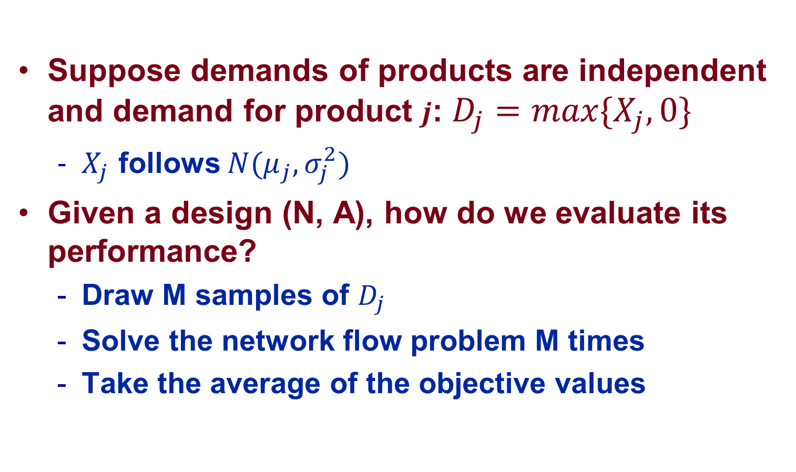
If demand is random…
Suppose demands of products are independent and demand for product $j$: $D_{j}=max\{X_{j},0\}$
  $X_{j}$ follows $N(μ_{j},σ_{j}^{2})$
Given a design (N, A), how do we evaluate its performance?
  Draw M samples of $D_{j}$
  Solve the network flow problem M times
  Take the average of the objective values

Slide 59
How to improve upon the dedicated system?
100
20
100
80
100
140
100
100
100
140
100
120

Slide 60
Open Chain
100
20
100
80
100
140
100
100
100
140
100
120

Slide 61
Long Chain
100
20
100
80
100
140
100
100
100
140
100
120

